Slide 1


Mastering Shipping Market Uncertainty:
Wet & Dry Bulk Indices Outlook
NATIONAL TECHNICAL UNIVERSITY OF ATHENS

Slide 2
Presentation Outline
Introduction
Methodology
Data
Performance of Shipping System Forecasting
Forecast
Conclusions

Slide 3
Introduction
Problem – Scope
Problem
  Shipping Decisions (Tactical, Strategic and Financial) are Taken Under Uncertainty Hence Often are Proved Wrong.
Scope
  Development of an Expert Decision Support System Aiming to Provide High Quality Information, Minimize Uncertainty and Improve Financial Performance.

Slide 4
Methodology
Research Fundamentals
Stochastic Models
  GARCH Heteroscedasticity (Kavussanos et al 2002, Lyridis et al 2005)
  Ornstein-Ühlenbeck Process (Bjerksund & Ekern, 1995; Tvedt, 1997; Martinussen, 1993)
  Geometric Mean Reversion (GMR) Process (Tvedt, 1997)
  ARIMA (Cullinane 1992, Bachelor et al 2003, Lyridis et al 2005)
  Non-Parametric Techniques (Adland, 2003).
Characteristics
  Ability to Model Uncertainty
  Inefficient Modeling of Causality

Slide 5
Methodology
Research Fundamentals
Econometric Explanatory Models of Shipping
  Static Models of Supply and Demand (Zannetos, 1966, Norman, 1979 & 1981, Evans 1994).
  Dynamic Models of Supply and Demand (Eriksen & Norman 1976, Strandenes 1986, Beenstock & Vergotis 1989, Lensberg & Rasmussen 1992).
Characteristics
  Deficient Modeling of Causality
  Large Number of Econometric Formulas and Variables
  Inability to Model Uncertainty

Slide 6
Methodology
Research Fundamentals
Data Mining Explanatory Models
  Artificial Neural Networks (Parsons & Lee 1997, Lyridis et al 2004)
  Hybrid Methods ANFIS (Lyridis et al 2005)
Characteristics
  Exceptional Ability to Describe Causality
  Inability to Model Uncertainty

Slide 7
Methodology
Schematic Approach

Slide 8
Methodology
System Analysis
Demand Indicators
External Factors:
Global Economy and Development Rates
Geopolitical Events.
Military Actions.
Oil or Commodities Reserves.
Climate Conditions
New Producers - Consumers
Commodities Prices– Arbitrage – Exchange Rates
Shipping Internal Factors:
Freight Rates
Supply for Transport Services
Laid up Vessels
Slow Steaming Vessels
Demolitions
Obo Vessels
Loses
Deliveries
Orderbook
Fixtures
Newbuilding Prices
Second Hand Prices
Demolition Prices
Supply Indicators
Production – Transportation:
Oil
Iron-ore
Coal etc
Demand for Sea Transport Services
Freight Rate Generation Model
Freight Rates

Slide 9
Methodology
Baltic Dirty Tanker Index Modeling
Supply Indicators
Demand Indicators
External Variables
BDTI₁
BDTI₂
Current Shipping Market Variables
ANN_{1->12}
BDTI₃
.
.
.
BDTI₁₂

Slide 10
Methodology
Baltic Dry Index Modeling
Supply Indicators
Demand Indicators
External Variables
BDI₁
BDI₂
Current Shipping Market Variables
ANN_{1->12}
BDI₃
.
.
.
BDI₁₂

Slide 11
Methodology
Baltic Capesize Index Modeling
Supply Indicators
Demand Indicators
External Variables
BCI₁
BCI₂
Current Shipping Market’s Variables
ANN_{1->12}
BCI₃
.
.
.
.
BCI₁₂
BDI₁
BDI₂
BDI₃
.
BDI₁₂
.

Slide 12
Methodology
Handy Size 30K 10y Secondhand Price Modeling
Supply Indicators
Demand Indicators
ANN₁
SHP₁
External Variables
ANN₂
SHP₂
ANN₃
SHP₃
.
.
Current Shipping Market Variables
.
.
.
.
ANN₁₂
SHP₁₂

Slide 13
Methodology
Explanatory Model Formulation
Preprocessing of Independent Variables
  Use of Expert Judgment, Correlation Coefficient: Attempt to Transfer Information from the Independent Variables to the Dependant
  Appropriate Transformation – Moving Averages, First and Second Order Differences, Returns etc.
  Test for Existence of Colinearity with:
    Bivariate Correlation
    VIF (Variance Inflation Factor)

Slide 14
Methodology
Explanatory Model Formulation
Training and Validation Explanatory Matrixes Construction for 1 to12 Months Ahead
  E.g. For the Baltic Dry Index Case:
    BDI: Independent Internal Variable
    China Industrial Production Index 12 Moving Average: Independent External Indicator Variable With 12 Months Time Lead
    Supply of Tonnage: Independent Internal Variable
    Supply of Tonnage Yr/Yr%,: Independent Internal Variable
    Supply of Tonnage Yr/Yr%, 3 Moving Average: Independent Internal Indicator Variable With 3 Months Time Lead
    Supply of Tonnage Yr/Yr%, 9 Moving Average : Independent Internal Indicator Variable With 9 Months Time Lead
    BulkCarrier New Building Price: Independent Internal Variable
    BDI (1 to 12M): Dependent Internal Variable With up to 12 Months Ahead

Slide 15
Methodology
Explanatory Model Formulation
Explanatory Model Selection
  Modular Artificial Neural Networks
    Not fully Interconnected Neurons
    Reduced Number of Weights
    Reduced Demand for Data Feed
    Increased Effort to Achieve Optimum Topology

Slide 16
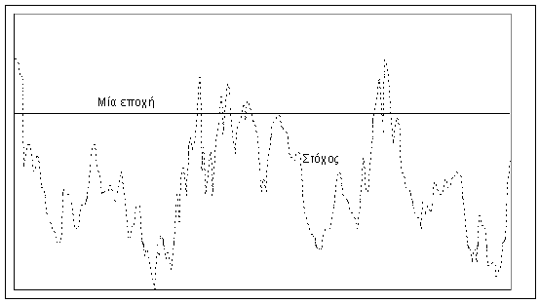
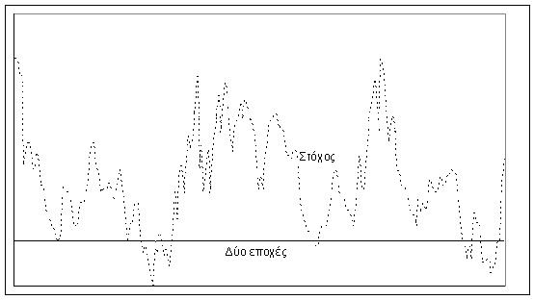
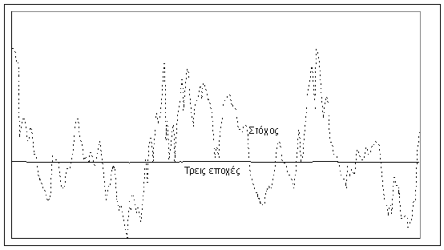
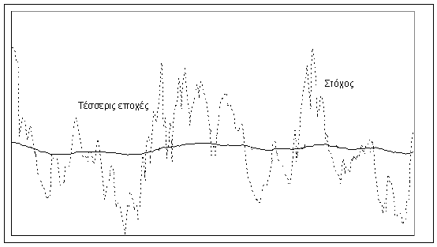
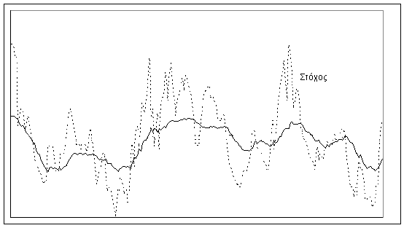
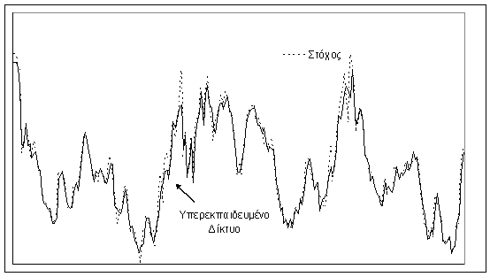
Methodology
Explanatory Model Formulation
Process (1 epoch)
  Input
  Output
  Target / Output Comparison
  Weight Tuning
Overtraining
vs
Generalization
A.N.N.
-
X1
Υ1
Υ2
●
●
●
●
●
Υn-1
Υn
Υ1
T1
X2
-
Υ2
T2
-
Xn-2
Υn-2
Tn-2
Xn-1
-
Υn-1
Tn-1
-
Xn
Υn
Tn

Slide 17
Data
Current Shipping Market Variables
Notes:
© 2003 FreightMetrics All rights reserved.
16

Slide 18
Data
Current Shipping Market Variables
Notes:
© 2003 FreightMetrics All rights reserved.
17

Slide 19
Data
Current Shipping Market Variables
Notes:
© 2003 FreightMetrics All rights reserved.
18

Slide 20
Data
Current Shipping Market Variables
Notes:
© 2003 FreightMetrics All rights reserved.
19

Slide 21
Data
Current Shipping Market Variables
Notes:
© 2003 FreightMetrics All rights reserved.
20

Slide 22
Data
Current Shipping Market Variables
Notes:
© 2003 FreightMetrics All rights reserved.
21

Slide 23
Data
Current Shipping Market Variables
Notes:
© 2003 FreightMetrics All rights reserved.
22

Slide 24
Data
Current Shipping Market Variables
Notes:
© 2003 FreightMetrics All rights reserved.
23

Slide 25
Data
Current Shipping Market Variables
Notes:
© 2003 FreightMetrics All rights reserved.
24

Slide 26
Data
External Variables
Notes:
© 2003 FreightMetrics All rights reserved.
25

Slide 27
Data
External Variables
Notes:
© 2003 FreightMetrics All rights reserved.
26

Slide 28
Data
Supply Indicator (Forecast)
Notes:
© 2003 FreightMetrics All rights reserved.
27

Slide 29
Data
Supply Indicator (Forecast)
Notes:
© 2003 FreightMetrics All rights reserved.
28

Slide 30
Data
Demand Indicator (Forecast)
Notes:
© 2003 FreightMetrics All rights reserved.
29

Slide 31
Data
Demand Indicator (Forecast)
Notes:
© 2003 FreightMetrics All rights reserved.
30

Slide 32
ANN Performance
Past Model Performance
Improved Modeling for the Baltic Dry Index Forecasting (Monthly Average Value)
  Congestion Factor.
      The Supply-Demand Equilibrium Mechanism Has a New Parameter Influencing the Generation of Freight Rates
      The Congestion Factor Causes an Indirect Supply Decrease
  Currency Units ($) per SDR
      The SDR Currency Value Is Determined by Summing the Values in US$, Based on Market Exchange Rates, of a Basket of Major Currencies ($, €, ¥, ₤)
      Currency Units per SDR is the Reciprocal of the SDR per Currency Unit Rate, e.g. 1 SDR = US$ 1.56936 (Monday, October 29, 2007)

Slide 33
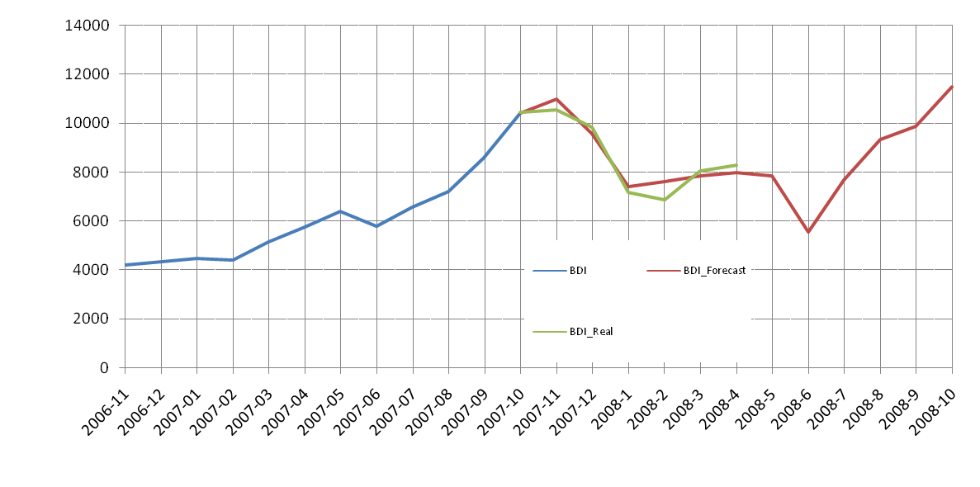

ANN Performance
Past Model Performance
Presented at the MARE FORUM Conference in November 2007 (Amsterdam)

Slide 34
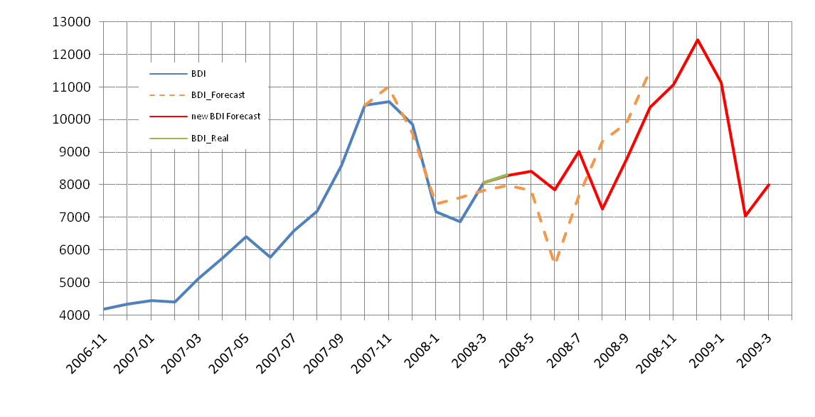
Forecast
Baltic Dry Index

Slide 35
Forecast
Baltic Dirty Tanker Index

Slide 36
Forecast
Baltic Capesize Index

Slide 37
Forecast
Secondhand Prices

Slide 38
Conclusions
Use of Supply and Demand Indicators has Improved Performance as Compared to Models that Take into Account Only Past and Present Information
All ANN Models Have Exceptional Performance When Fed with Real S/D Indicators During Test
(BCI Modeling incorporate BDI Projections. The Corresponding ANN Has Exceptional Performance When Fed with Real BDI Values During Test)
Future Indicators Values are Based on Expert Outlook Reports/Literature

Slide 39
Conclusions
Past Data for the Industrial Production of China Present a Volatility that Cannot be Seen in Forecasted Values. Thus Moving Average Smoothing Has Been Applied to the Time Series
Models Performance Should be Checked for 3 to 4 Months (Calibrated) Against Real Indices Values
Main Concern is Accuracy and/or Modeling Efficiency of S/D Indicators

